Slide 1
EEET2481 Embedded Systems Design and Implementation
Tutorial 2 – Accompany Slides

Slide 2
Previously
Study Clock controller
Practice
Got a step ready
Take out the table
Transfer to code

Slide 3
Example - NUC140 MCU clock configuration
Task 1 - Configure the NUC140 MCU to use HXT (12 MHz) as a clock source to generate and provide a 50 MHz clock signal to the microprocessor core via PLL core.
Task 2 - In the main program, toggle a GPIO pin and then measure its blinking frequency to validate the success of the clock configuration

Slide 4
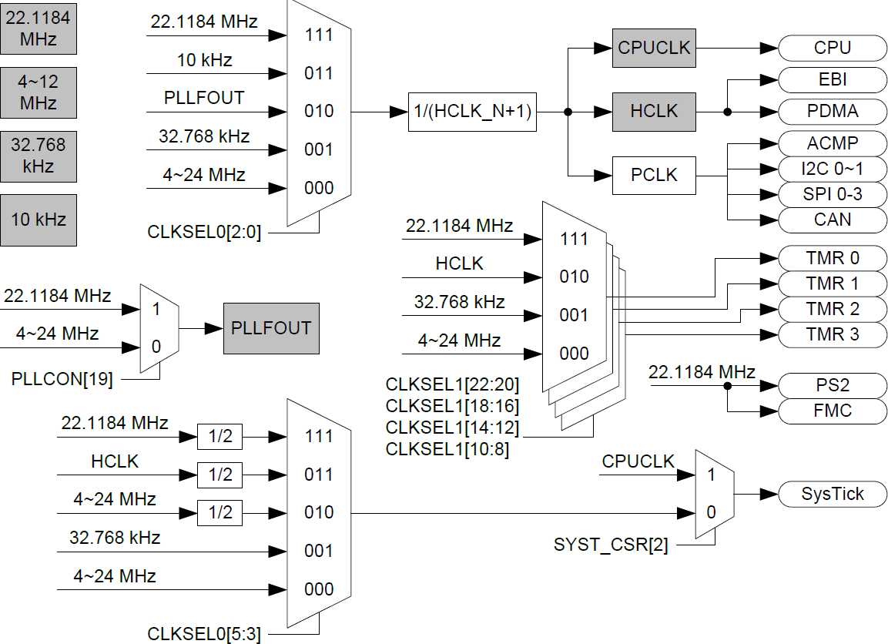
Clock Routing Paths in NUC140 MCU

Slide 5
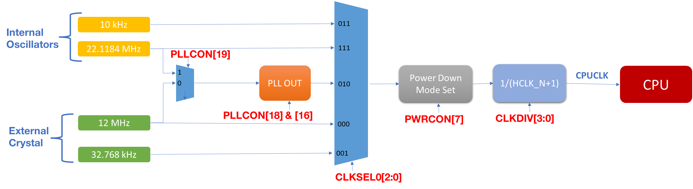
Simplified Diagram
Example: configure the NUC140 MCU to use HXT (12 MHz) as a clock source to generate and provide a 50 MHz clock signal to the microprocessor core.
Input clock source is from HXT via PLLOUT
Output clock is 50MHz

Slide 6
Step 0 - Unlock protected registers
As we are configuring some protected registers involving clocks, at the beginning of the process, we must unlock these prior to writing new changes.
We will lock registers once we complete.
SYS_UnlockReg(); // Unlock protected registers

Slide 7
Step 1

Slide 8
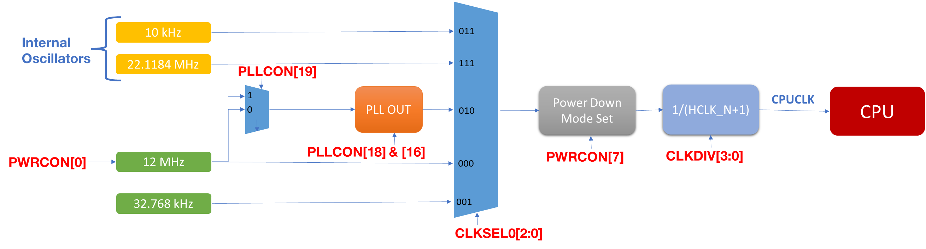
Step 1: Enable and configure clock sources
Step 1A - since we want to use HXT as the clock source, HXT must be enabled:
PWRCON[0] is set to 1.
Wait for HXT to be stable before we can configure.
CLK->PWRCON |= 1<<0;
#define HXT_STATUS 1<<0
while(!(CLK->CLKSTATUS & HXT_STATUS));

Slide 9
Review - Bit Manipulation for Masking

Slide 10
Bit Manipulation for Masking
How can we check the value of a bit in a multiple-bit number if it is 0 or 1?
-> Apply Bit manipulation to mask the value of the bit
Step 1 – Masking the bit out of the original number
identify the bit location m
shift left 1 by m position
AND the number with the shift left from step b
Step 2 – Check the result from step 1
8-bit register A = 0b XXXX_1X10
Check if the value of the bit 2 is 1
Step 1a & 1b
(1<<2) -> result in 100 (our mask)
Step 1c
A & (1<<2)
XXXX_1X10
&
0000_0100
Result:
0000_0X00
Step 2 – check the result
if(A & (1<<2) ) - if X = 1 -> if(true)

Slide 11
Bit Manipulation for Masking (2)
How can we check the value of a bit in a multiple-bit number if it is 0 or 1?
-> Apply Bit manipulation to mask the value of the bit
Step 1 – Masking the bit out of the original number
identify the bit location m
shift left 1 by m position
AND the number with the shift left from step b
Step 2 – Check the result from step 1
8-bit register A = 0b XXXX_1X10
Check if the value of the bit 2 is 0
Step 1a & 1b
(1<<2) -> result in 100 (our mask)
Step 1c
A & (1<<2)
XXXX_1X10
&
0000_0100
Result:
0000_0X00
Step 2 – check the result
if(!A & (1<<2) ) - if X = 0 -> if(true)

Slide 12
Masking for Multiple Bits
Masking can expand to multiple bits
8-bit register A = 0b 1010_1111
Mask out value of the first 4 bits
A[7:4]
Step 1a & 1b
(0b1111<<0)
-> result in 1111_0000 (our mask)
Step 1c
A & (0b1111<<0)
1010_1111
&
1111_0000
Result:
1010_0000

Slide 13
Step 1: Enable and configure clock sources
Step 1B – As we need to use PLL, we will select HXT as input clock source for PLLOUT:
PLLCON[19] is clear to 0
CLK->PLLCON &= (~(1<<19));

Slide 14
Step 1: Enable and configure clock sources
Step 1C – We are using normal mode so:
PLLCON[16] is clear to 0.
CLK->PLLCON &= (~(1<<16));

Slide 15
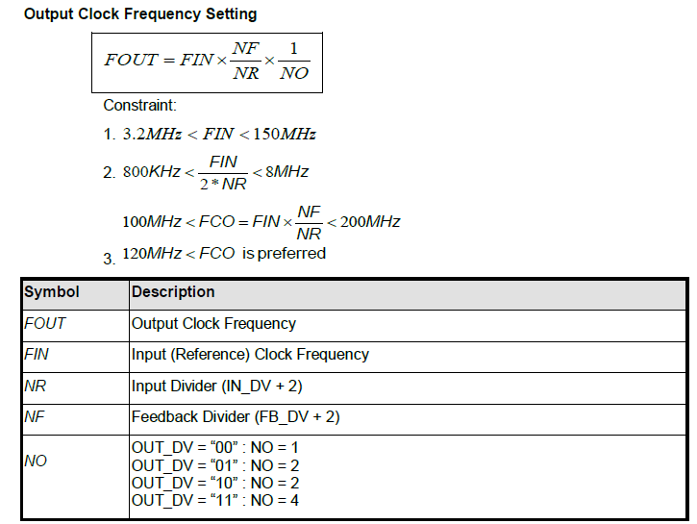
Step 1: Enable and configure clock sources
Step 1D – Calculate values for registers to get the desirable output frequency - 50MHz
Since FIN is HXT=12MHz, you can select NF=50, NR=3, NO=4
PLLCON[8:0] is set to 48 (i.e., FB_DV=48→NF=48+2=50)
PLLCON[13:9] is set to 1 (i.e., IN_DV=1→NR=1+2=3)
PLLCON[15:14] is set to 3 (i.e., OUT_DV=0b11→NO=4)

Slide 16
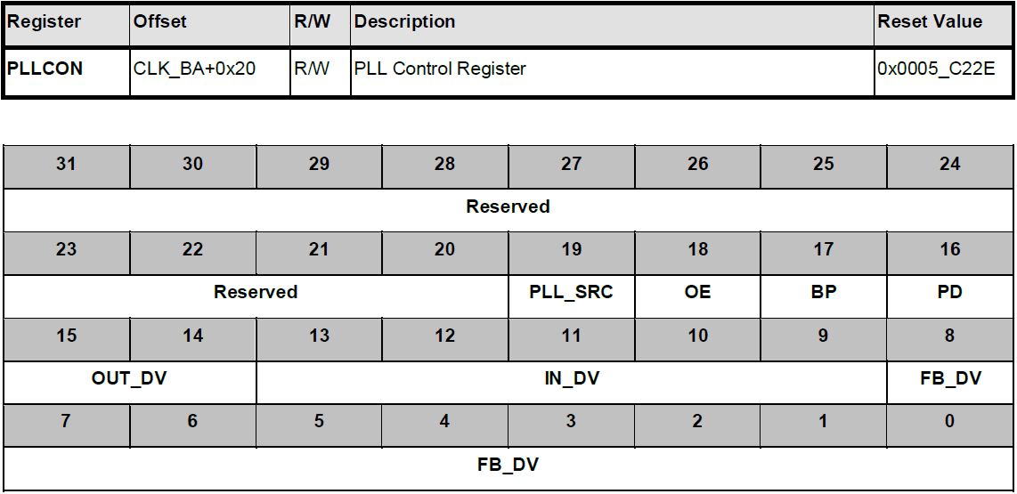
Step 1: Enable and configure clock sources
Step 1D
PLLCON[8:0] is set to 48 (i.e., FB_DV=48→NF=48+2=50)
PLLCON[13:9] is set to 1 (i.e., IN_DV=1→NR=1+2=3)
PLLCON[15:14] is set to 3 (i.e., OUT_DV=0b11→NO=4)
PLLCON[15:0] is set to 0b1100_0010_0011_0000 or 0xC230

Slide 17
Step 1: Enable and configure clock sources
Step 1D – Put the calculated register value:
Clear the previous value if any
Set new value 0xC230
CLK->PLLCON &= (~(0xFFFF << 0));
CLK->PLLCON |= 0xC230; //

Slide 18
Step 1: Enable and configure clock sources
Step 1E - To enable PLLOUT output:
PLLCON[18] is clear to 0
Wait for the PLL signal to stable – this is the end of step 1
CLK->PLLCON &= (~(1<<18));
#define PLL_STATUS 1<<2
while(!(CLK->CLKSTATUS & PLL_STATUS));

Slide 19
Step 2

Slide 20
Step 2: Select the clock sources
Step 2A – Allow the clock calculated earlier flowing to the CPU - PLLOUT must be selected for CPU
Clear value if any
CLKSEL0[2:0] is set to 0b010
CLK->CLKSEL0 &= (~(0x07<<0));
CLK->CLKSEL0 |= 0b010;

Slide 21
Step 2: Select the clock sources
Step 2B – Power Down Mode Set
PWRCON[7] is 0b0. This is a default/reset value -> no change in the code.

Slide 22
Step 2: Select the clock sources
Step 2C – Check if we need to divide the clock frequency further
Since we got 50MHz, so here we will not use the clock frequency divider anymore
CLK->CLKDIV &= (~(0x0F<<0));

Slide 23
Step 3 - Lock protected registers
We will lock registers once we complete.
SYS_LockReg(); // Lock protected registers

Slide 24
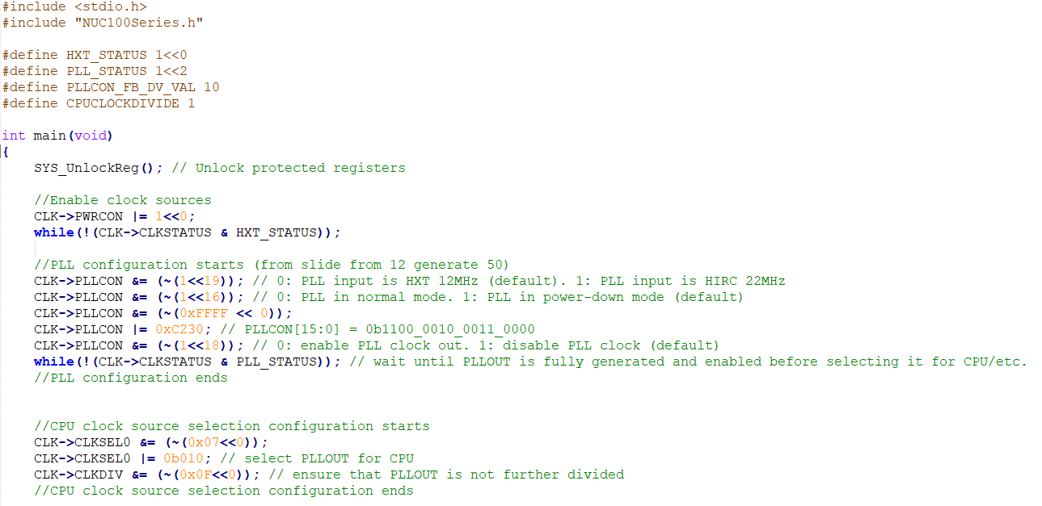
Full Program
Upload on Canvas

Slide 25
Test the Clock Configuration

Slide 26
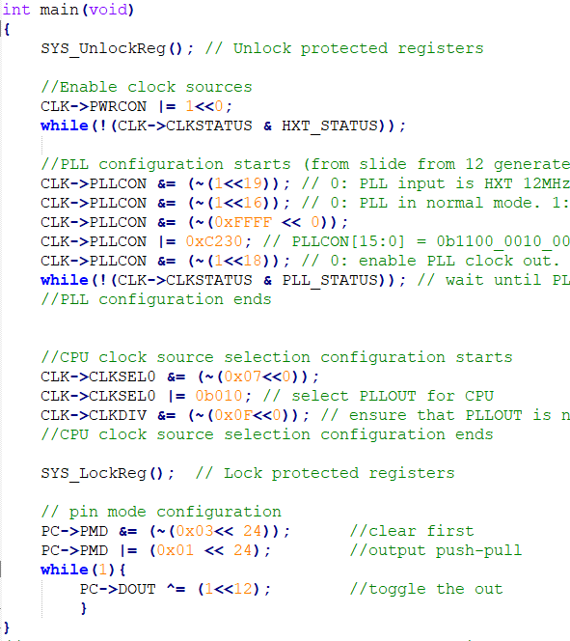
Toggle a GPIO pin to confirm frequency
Be discussed in Tutorial 3

Slide 27
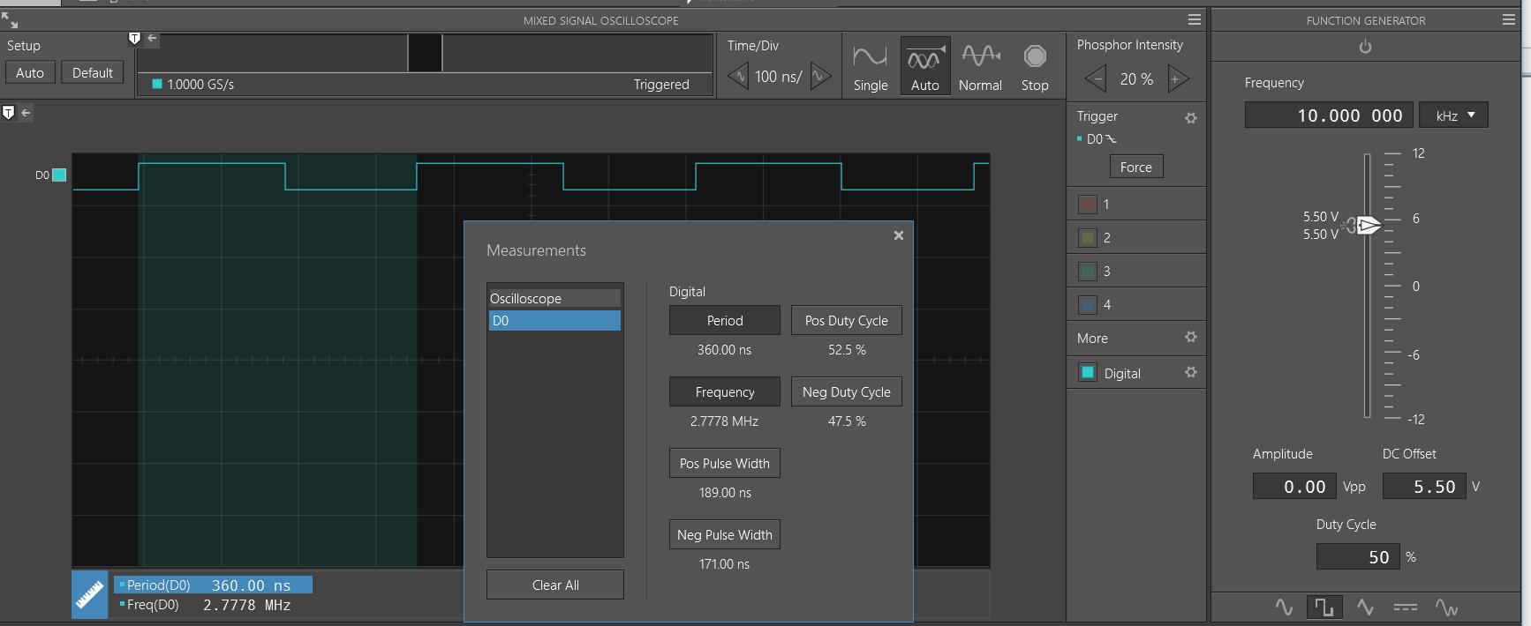
Measurement
The blinking frequency is 2.7 MHz

Slide 28
Tutorial Question 1
Question 1: With the current clock configuration code, what is the clock source and clock frequency of the MCU according to the Manual?

Slide 29
Tutorial Question 2
Question 2: What is the output signal frequency generated at GPIO port C pin 12 (i.e., the LED5’s flashing frequency) from the measurement?

Slide 30
Tutorial Question 3
Question 3: Study the manual and lecture, then modify the current embedded software program to decrease CPU clock frequency by 50% compared to the existing code. Build and load the new program to the board. Then, confirm the flashing frequency of the GPC12 (LED5). Explain your changes and include the snapshot from the measurement equipment.

Slide 31
Tutorial Question 4
Question 4: Study the manual and lecture, then modify the current embedded software program to change the MCU clock frequency to 36 MHz (PLL should be used as the CPU’s clock source). Build and load the new program to the board. Then, confirm the flashing frequency of the GPC12 (LED5). Explain your changes and include the snapshot from the measurement equipment.

Slide 32
Note
Check solutions from Tutorial 2 Sample Solution.

Slide 33
— Thank you

